Slide 1
Quantitative Trait Mapping with qtl2
Sue McClatchy, The Jackson Laboratory
Dan Gatti, The Jackson Laboratory

Slide 2
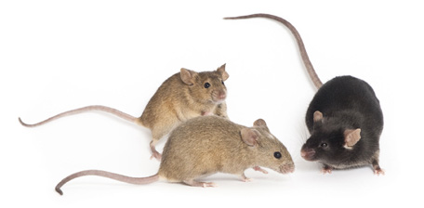
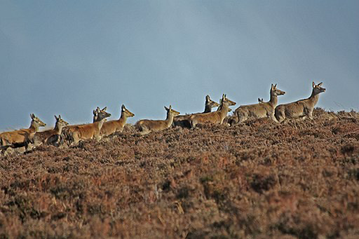
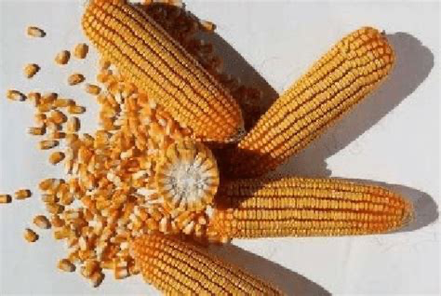
Mapping in biomedical, agricultural & evolutionary studies
Diversity Outbred mice
jax.org
Zheng 958 maize
Li X, Du Y, Guo J and Mao E. Appl Sci 2020, 10. researchgate.net
The Wild Red Deer of Exmoor
John Shortland
Wikimedia Commons
Notes:
Quantitative trait mapping is used in biomedical, agricultural, and evolutionary studies to find causal genes for quantitative traits, to aid crop and breed selection in agriculture, and to shed light on natural selection.
Examples of quantitative traits include cholesterol level, plant yield, or birth weight, all of which are continuous variables.
The goal of quantitative trait locus (QTL) analysis is to identify genomic regions linked to a phenotype, to map these regions precisely, and to define the effects, number, and interactions of QTL.

Slide 3
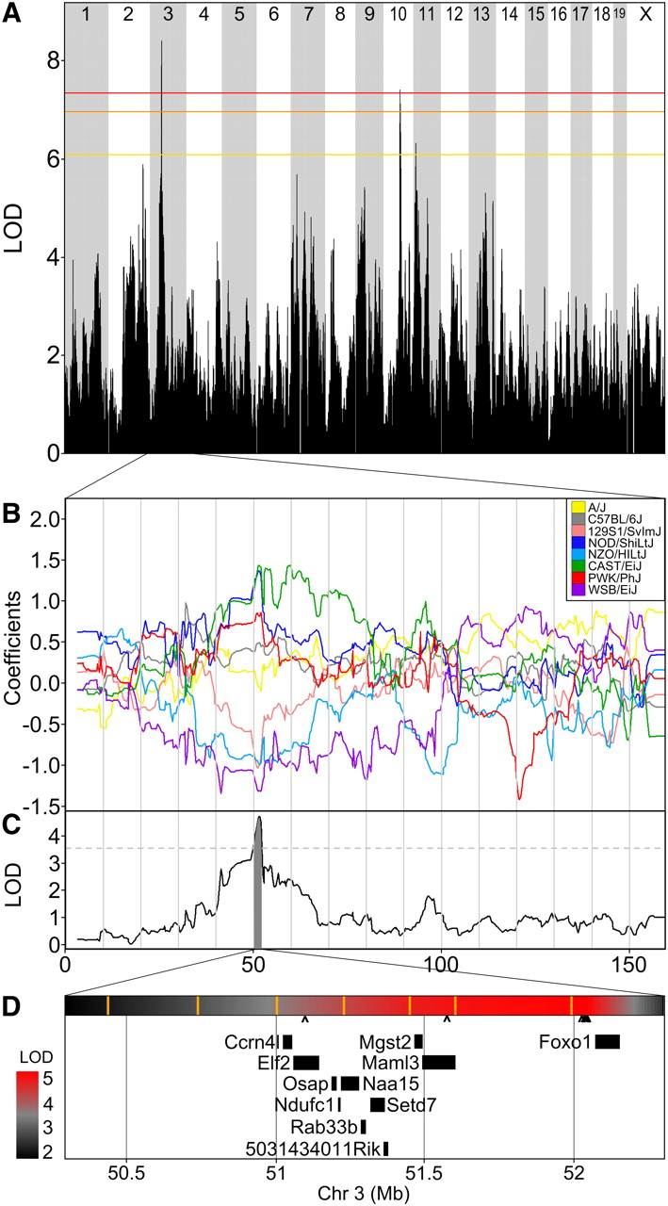

Figure 6 Change in plasma cholesterol has a significant QTL on chromosome 3.
QTL mapping in biomedicine aims
to identify causal genes for
quantitative traits like cholesterol levels
Notes:
Figure 6 Change in plasma cholesterol has a significant QTL on chromosome 3.
(A) Genome-wide scan for change in cholesterol from 7 to 18 weeks of age. Colored lines show permutation-derived significance thresholds at P = 0.05 (red), P = 0.10 (orange), and P = 0.63 (yellow).
(B) The eight coefficients of the QTL model show the effects on the phenotype contributed by each founder haplotype on chr 3.
(C) QTL plot for the chr 3 locus. Shading identifies a two-LOD support interval. Dashed line is maximum LOD −2.
(D) Expansion of the two-LOD support interval containing 11 genes. A heatmap of the QTL P-value is shown above the gene locations with SNP locations indicated by orange vertical bars. The scale of significance (red most significant) is shown on the left. The seven Sanger SNPs that match the founder effect pattern are marked beneath the heat map with carats (^); five of these cluster upstream of Foxo1.
Unless provided in the caption above, the following copyright applies to the content of this slide: © Genetics 2012 This article is published and distributed under the terms of the Oxford University Press, Standard Journals Publication Model (https://academic.oup.com/journals/pages/open_access/funder_policies/chorus/standard_publication_model)

Slide 4
QTL mapping in agriculture aids
crop selection and improvement
Yang, J., Liu, Z., Chen, Q. et al. Mapping of QTL for Grain Yield Components Based on a DH Population in Maize. Sci Rep 10, 7086 (2020).

Slide 5
Mapping birth weight in a
natural population sheds light
on natural selection
Slate J, Visscher PM, MacGregor S, Stevens D, Tate ML, Pemberton JM. A genome scan for quantitative trait loci in a wild population of red deer (Cervus elaphus). Genetics. 2002 Dec;162(4):1863-73.

Slide 6
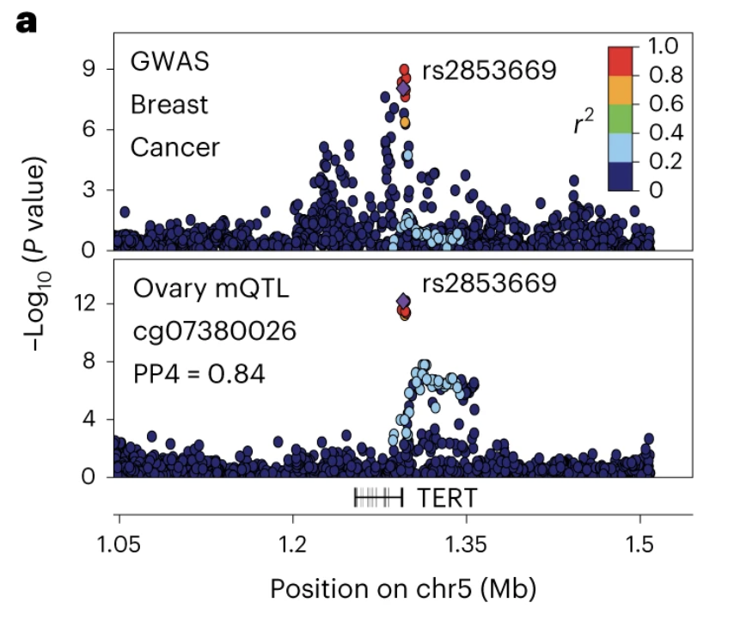
Human studies - expensive, lack environmental control, confounded
Oliva, M., Demanelis, K., Lu, Y. et al. DNA methylation QTL mapping across diverse human tissues provides molecular links
between genetic variation and complex traits. Nat Genet 55, 112–122 (2023)
Notes:
Human studies are very expensive. Studies in natural populations such as humans or wild red deer lack environmental control.
They are prone to being confounded by population structure such that associations between genotype and phenotype are not necessarily causal.

Slide 7
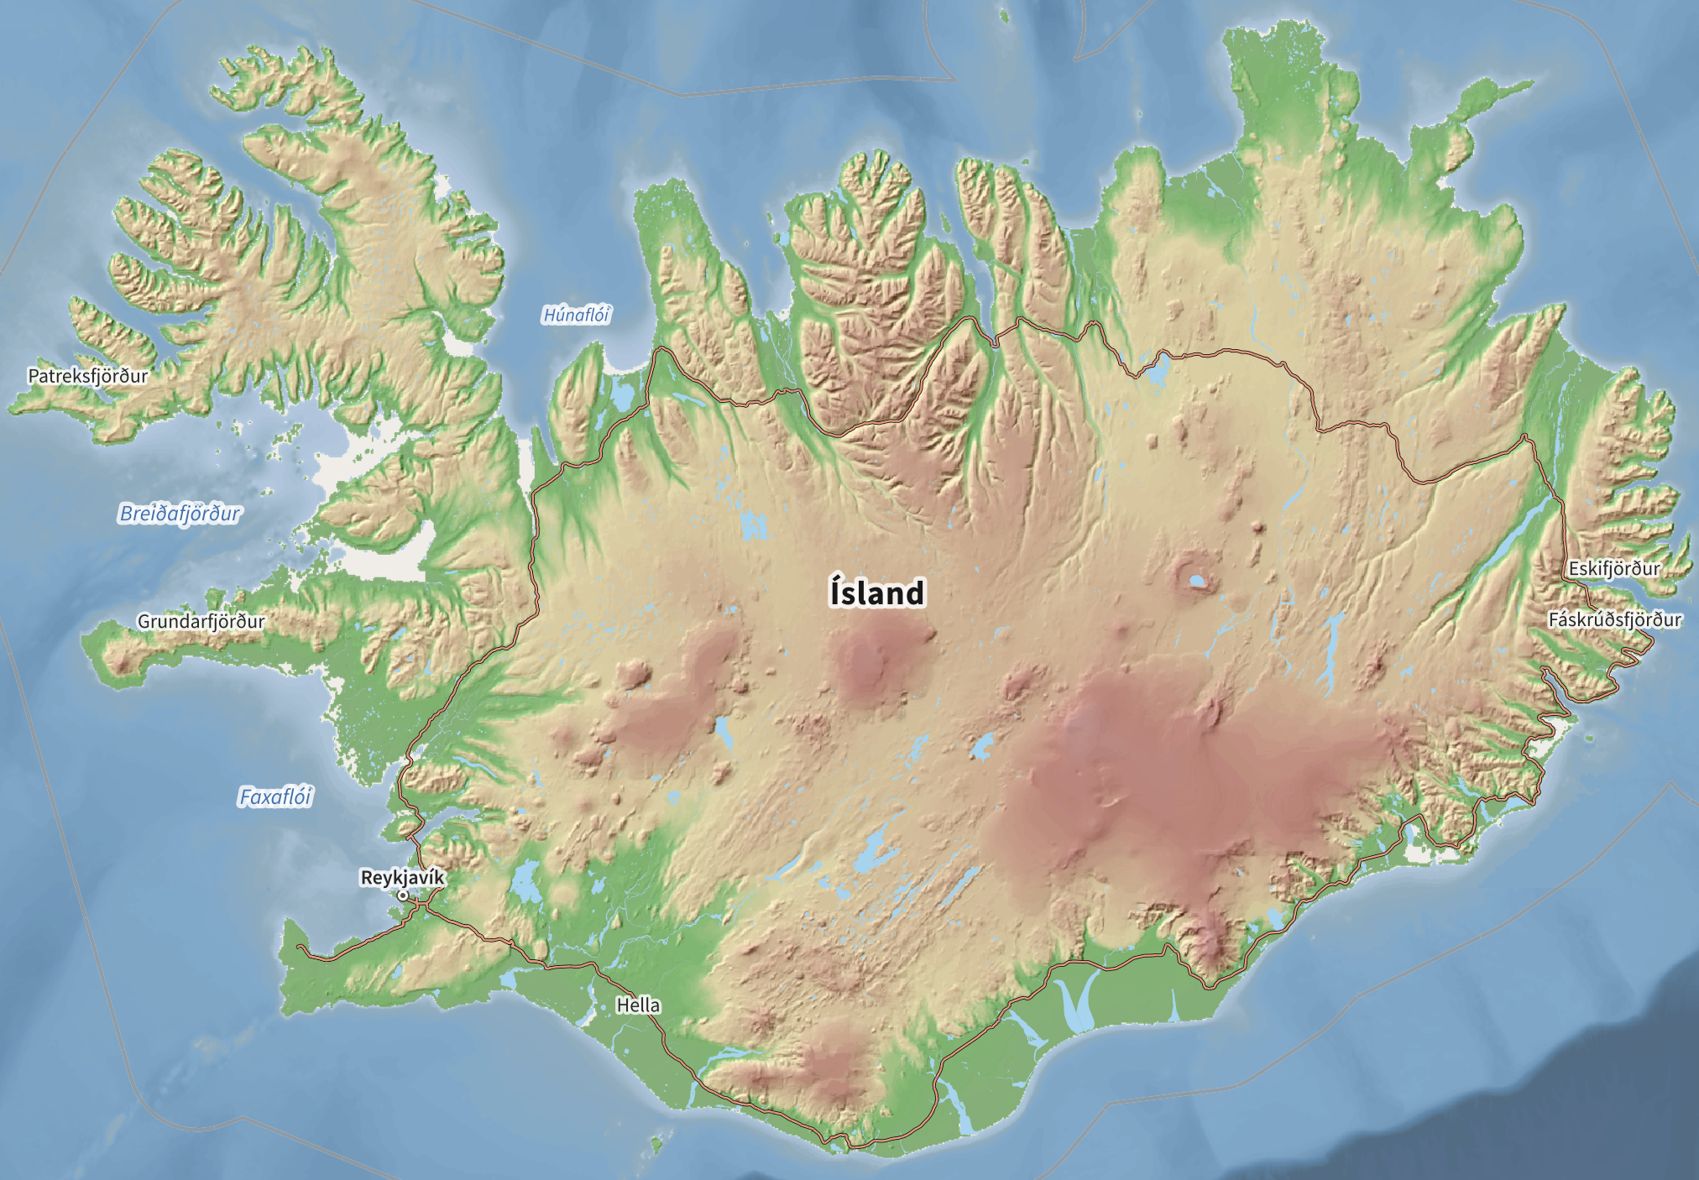
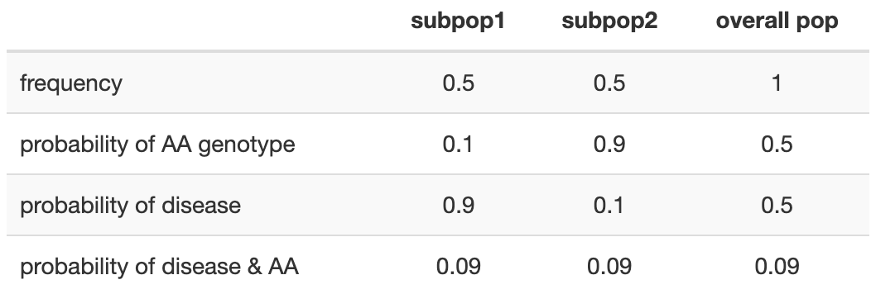
Confounding by population
structure
Notes:
Case-control studies are often confounded when hidden subpopulations with different allele frequencies and disease probabilities are present in the study.
If a study sample includes an unknown subpopulation of Icelanders, for example, most of the cases will come from this unknown subpopulation that in this case has a high probability of disease but a low probability of having the AA genotype.
The study will be confounded by population structure and the association between genotype and phenotype not causal.

Slide 8
Two or more strains that differ genetically
a marker
R/qtl2: high-dimensional data and multi-parent populations. kbroman.org/talks.html
Notes:
QTL analysis in experimental crosses requires two or more strains that differ genetically with regard to a phenotype of interest. Genetic markers, such as SNPs or microsatellites, distinguish between parental strains in the experimental cross
Markers that are genetically linked to a phenotype will segregate more often with phenotype values (high or low values, for example), while unlinked markers will not be significantly associated with the phenotype. The markers themselves might be associated with the phenotype but are not causal. Rather, markers may be associated with the phenotype through linkage to nearby QTL. They serve as signposts indicating the neighborhood of a QTL that influences a phenotype. Covariates such as sex or diet can also influence the phenotype.

Slide 9
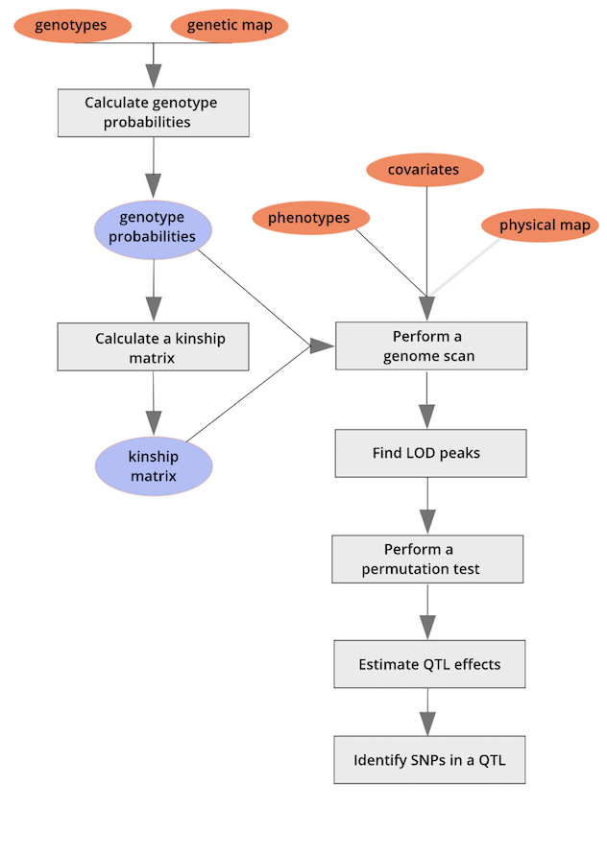
Mapping workflow

Slide 10
